Slide 1
Software QA and Testing with Automation using Selenium IDE Course 1, Class 3 Deck 3 Selenese Basics
Instructor
David F Wagoner
PMP, CSQE, CMQ/OE

Slide 2
Selenese
Three types of commands
Actions
These do something to the application in the browser to perform an action inside the browser
Failure to perform an action causes script failure and halt
Accessors
Allow you to access the state of the application and store that information in a variable
Assertions
Verifies the state of the application or object is what is expected
Three types of assertions
Assert, verify, waitfor

Slide 3
Selenese
Assertions
Assert
Looks at an object (page, page element, internal variable) and determines whether a condition exists
Does the title, a link, an object have specific text or values?
If not, the test fails and halts
Verify
Same as assert but when it fails, an error is logged and script execution continues
Waitfor
Waits for a condition to be true
If the condition is false and the timeout setting is exceeded, the script will fail and halt
When to use assert instead of verify

Slide 4
Selenese
Script syntax
There are three elements, a command and two optional parameters
Commands
Verify text, assert something or put something
Parameters
Whether either parameter is necessary is determined by the command
Locate some thing on a page
Text or state information for assert or verify
Text or state information to put
Recall that all of this is stored as a 3 column html table
Command, Parameter 1, Parameter 2

Slide 5
Selenese
Common Selenese commands
open
opens a page using a URL.
click/clickAndWait
performs a click operation, and optionally waits for a new page to load.
verifyTitle/assertTitle
verifies an expected page title
verifyTextPresent
verifies expected text is somewhere on the page
verifyElementPresent
verifies an expected UI element, as defined by its HTML tag, is present on the page
verifyText
verifies expected text and its corresponding HTML tag are present on the page
verifyTable
verifies a table’s expected contents
waitForPageToLoad
pauses execution until an expected new page loads. Called automatically when clickAndWait is used
waitForElementPresent
pauses execution until an expected UI element, as defined by its HTML tag, is present on the page

Slide 6
Selenese
Locating UI elements
Use Id and name instead of xpath
Xpath is used to locate items not explicitly named or identified and is beyond the scope of the course by:
Relative reference to a named or identified object
Absolute reference (not recommended)
Fails easily when developers move stuff around
CSS and DOM

Slide 7
Selenese
Pattern Matching (globbing)
Often useful to look for something based on a partial text match
Wildcard ‘*’
Identifies variable parts of text along with fixed parts
Dan* will find Dan, Dance and Dancing
Dan*g will only find Dancing
Brackets []
Locate any character in text that is within the brackets
[an] will find Dan, Dance and Dancing
[e] will find Dance

Slide 8
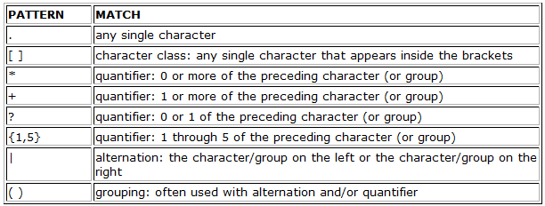
Selenese
Regular expression pattern matching
Prefixed by regexp: or regexp1:

Slide 9
Selenese
Using Variables
Names are alpha-numeric
The store command places the value of something, or a literal, into a variable
To access the value in a variable enclose the variable name in curly brackets and precede it with a $ e.g ${myVariable}

